Slide 1
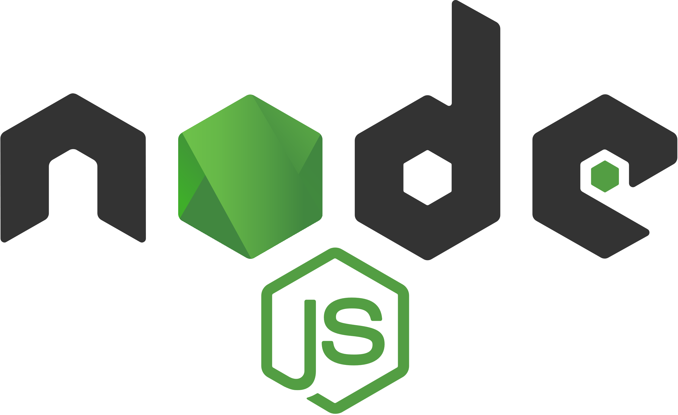
CPNT-262 Node.js

Slide 2
Local Modules

Slide 3
Node Modules
In the previous activities, we used built-in modules to add additional functionality to our app.js file.
You can also create your own modules to organize your code.
Organize all related code into a single file.
Keep modules small and specific.
Modules can be published to the npm registry and shared with the community.

Slide 4

Creating Modules
Modules can be either single files or directories containing one or more files.
If a module is a directory, the file in the module directory should be named index.js. You can change this in package.json

Slide 5
Activity: Currency Module
In your sait-node folder, create a new file named currency.js. This is your new module.
Add the following code to currency.js.
const canadianDollar = 0.76;
function roundTwo(amount) {
return Math.round(amount * 100) / 100;
}
exports.canadianToUS = canadian => roundTwo(canadian * canadianDollar);
exports.USToCanadian = us => roundTwo(us / canadianDollar);

Slide 6
module.exports
exports.canadianToUS = canadian => roundTwo(canadian * canadianDollar);
exports.USToCanadian = us => roundTwo(us / canadianDollar);
module.exports lets us set things for export
exports is a shorthand alias for module.exports (avoid using exports as a variable name or you’ll destroy this link)
Here, we’re exporting a function called canadianToUS so that other modules can use it.

Slide 7
Activity: Import Currency Module
In your sait-node folder, create a new file named test-currency.js.
Add the following code to test-currency.js.
Run the code in the terminal with node test-currency.js
// Load currency module
const currency = require("./currency");
// Use functions from currency module
console.log(`50 Canadian dollars equals ${currency.canadianToUS(50)} US dollars.`);
console.log(`50 US dollars equals ${currency.USToCanadian(50)} Canadian dollars.`);
Notes:
Here, we’re importing the currency module using the require module.

Slide 8
require
const currency = require("./currency");
require lets us specify modules to be imported into a current module
the .js extension is assumed, so you don’t need it
use relative paths

Slide 9
Activity: More Currencies
Create and export new functions to convert between Canadian dollars and British pounds.
You can Google the exchange rate.
Notes:
Here, we’re importing the currency module using the require module.

Slide 10
Node Package Manager (npm)

Slide 11
What is npm?
Package manager for Node.js packages (modules)
https://www.npmjs.com/ (discover and install public packages – free to use in your projects)
Installed automatically when you install Node.js

Slide 12
package.json
package.json is the configuration file used by the program npm, the Node Package Manager
You will be installing a lot of different things for your project (dependencies), and package.json keeps a list of things you installed. This helps you share the project with others.
package.json is also the configuration file for automating tasks and publishing your project

Slide 13
Creating a Node Project
So far, we’ve just been writing code, but it’s time for us to officially make this a real Node.js project

Slide 14
Activity: Start Node Project
Navigate to the sait-node folder in the terminal and then run npm init.
The npm command will ask you a few questions. You can hit enter to keep the default with the following changes:
Entry point should be app.js
Change the author name to your name!
In your sait-node folder, you should now see a package.json file.

Slide 15
Packages
Now that our project is official, we have a package.json file that allows us to store information about the project.
Now, we can install 3rd-party modules and save them to our project.

Slide 16
Installing Packages
Global – all global packages are placed in a single place on your system
npm install package-name –g
install packages globally when it provides an executable command that you run from the terminal, and it is reused across packages
Local – installed in the directory where you run the command; placed inside the node_modules folder within the directory
npm install package-name
installed as dependency for your project
npm install package-name --save-dev
installed as development dependency for your project
unneeded for production, but needed for your development workflow
Notes:
There are different ways to install packages, depending on what your project needs.

Slide 17
Nodemon
Let’s update our workflow. So far, we’ve had to restart the server every time we make a change. /yaaaaawwwn
Let’s use nodemon to automatically restart the server whenever changes are made.
Since nodemon gives us an executable command that we can run from the terminal (nodemon app.js instead of node app.js), we can install it globally!

Slide 18
Activity: Install a Global Package
In the terminal, run the following command.
npm install nodemon -g
Start up your server one more time, but this time use nodemon!
nodemon app.js

Slide 19
Nodemon, part 2
There is a growing concern that installing development packages globally means that it’s harder for others to quickly get up and running with your projects.
Installing packages like Nodemon as a local development dependency means that other people can just npm install to set up the project and everything you used.
Installing locally instead of globally also means that you have more control over the version of the package and that you don’t run into potential conflicts down the road.

Slide 20
Uninstalling Packages
Global
npm uninstall -g nodemon
Local (navigate to the root folder first)
npm uninstall nodemon
Local dev dependency (navigate to the root folder first)
npm uninstall --save-dev nodemon

Slide 21
Activity: Uninstall a global package
Uninstall Nodemon as a global package (you can always reinstall it later).

Slide 22
Activity: Install a Dev Dependency
In the terminal, navigate to your sait-node folder.
Install nodemon as a development dependency (we need it for our development workflow, but not for the project itself).
npm install nodemon --save-dev
nodemon app.js no longer works. We’ll need to edit our package.json file. Within “scripts”, add this after the test property
"start": "nodemon app.js"
Start up your server one more time, but this time using nodemon as a local package!
npm run start
Notes:
npm run start will check our package.json file for a script called start and run whatever is listed there. In this case, it will automatically run nodemon app.js for us.

Slide 23
Activity: Install a Package for Production
Install Moment.js (https://momentjs.com/docs)
Format the time as Month Day, Year (October 1st, 2019) - https://momentjs.com/docs/#/displaying/
Log the time to the console.
Notes:
npm run start will check our package.json file for a script called start and run whatever is listed there. In this case, it will automatically run nodemon app.js for us.

